Slide 1
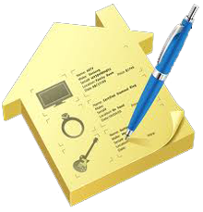
PROJECT IN ANDROID TECHNOLOGY
INVENTORY MANAGEMENT SYSTEM
SUBMITTED BY
SONAM KUMARI

Slide 2
Introduction
The project deals with the development of an android application which implements the inventory management in the industry.
This project is specifically developed for the management of android devices (tablets) used by the employees working in the industry.

Slide 3
Android Technology
Android is a software stack for mobile devices that includes an operating system, middleware and key applications.
It allows developers to write managed code in a Java-like language that utilizes Google-developed Java libraries, but does not support programs developed in native code.

Slide 4
What Androids Are Made Of
Activities
Services
Content Providers
Broadcast Receivers

Slide 5
Activities
The building block of the user interface is the activity.
An activity as being the Android analogue for the window or dialog box in a desktop application or the page in a classic web application.

Slide 6
Services
Activities are short-lived and can be shut down at any time. Services, on the other hand, are designed to keep running, if needed, independent of any activity.

Slide 7
Content Providers
Content providers provide a level of abstraction for any data stored on the device that is accessible by multiple applications.
The Android development model encourages you to make your own data available to other applications, as well as your own applications.

Slide 8
Broadcast Receivers
A broadcast receiver (short receiver) allows us to register for system or application events.
All registered receivers for an event will be notified by the Android runtime once this event happens.
For example ACTION_BOOT_COMPLETED system event which is fired once the Android system has completed the boot process.

Slide 9
Android Development Tools
Android SDK
Android Development Tool (ADT)
Dalvik Virtual Machine

Slide 10
Android SDK
The Android Software Development Kit (SDK) contains the necessary tools to create, compile and package Android application.
The Android SDK also provides an Android device emulator, so that Android applications can be tested without a real Android phone.
The Android SDK contains the Android debug bridge (adb) tool which allows to connect to an virtual or real Android device.

Slide 11
Android Development Tool (ADT)
ADT is a set of components (plug-ins) which extend the Eclipse IDE with Android development capabilities.
ADT also allows to create and start AVDs.
ADT provides specialized editors for resources files, e.g. layout files.

Slide 12
Dalvik Virtual Machine
The Android system uses a special virtual machine, i.e. the Dalvik Virtual Machine to run Java based applications.
Dalvik uses an own bytecode format which is different from Java bytecode.

Slide 13
Overview Of The Project

Slide 14
Goals And Technology
Our purpose is to keep record of all used and available devices based on QR code implementation.
The technology being used to develop the application is Android.

Slide 15

Snapshots Of Inventory Management System

Slide 16
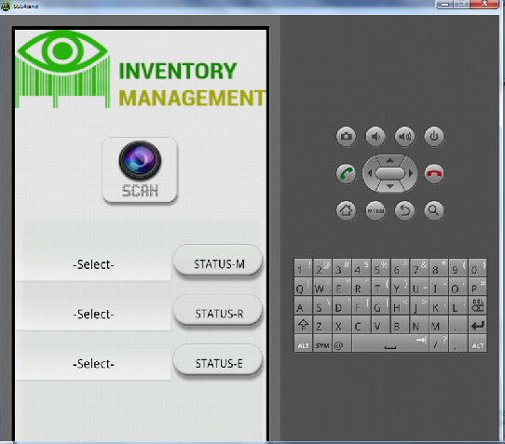
Launch Screen On Emulator

Slide 17
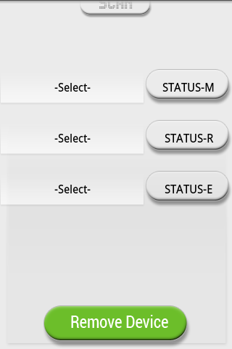
Scroll View

Slide 18
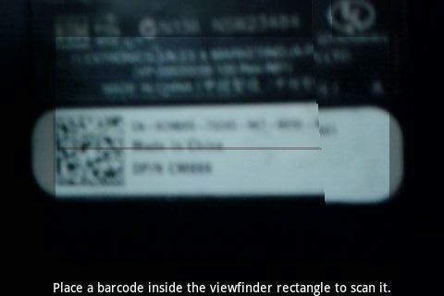
Scanner

Slide 19
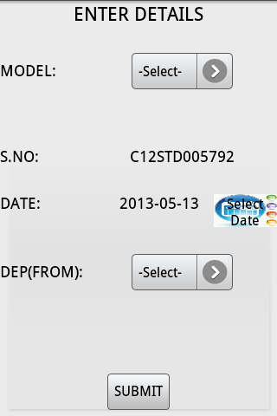
Enter Details

Slide 20
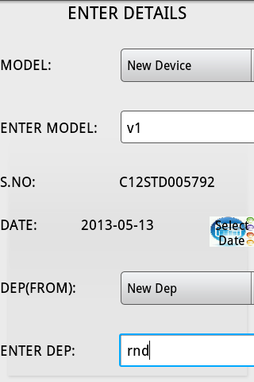

Slide 21
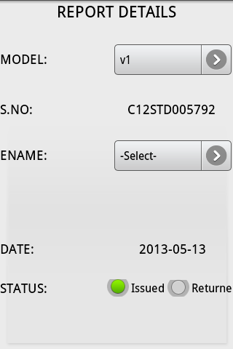
Report Details

Slide 22
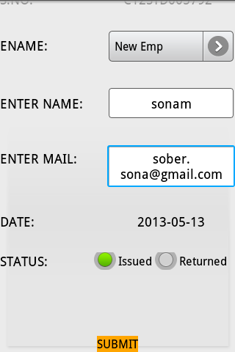
Report Details Scroll View

Slide 23
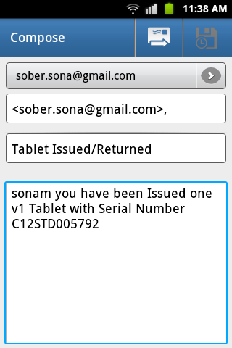
Mailing Interface

Slide 24
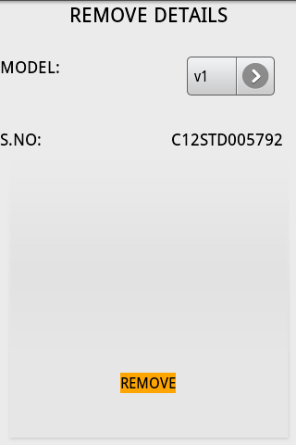
Remove Details

Slide 25
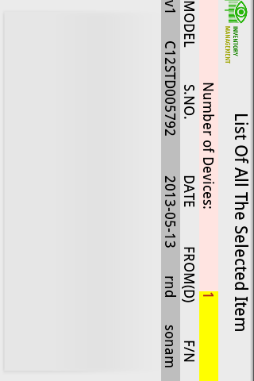
Master Database

Slide 26
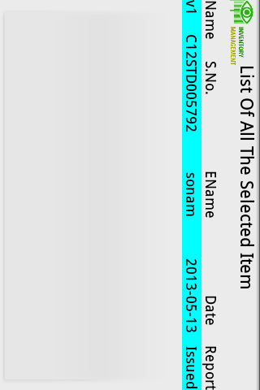
Employee Database

Slide 27
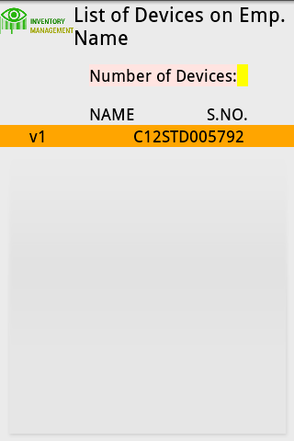
Report Database

Slide 28
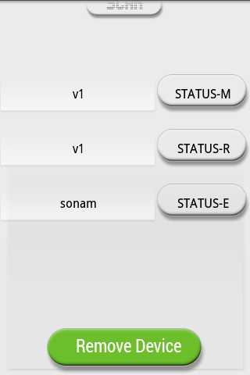
On Back Pressed

Slide 29


Slide 30

QUERIES….??

