Slide 1
FACES OF INDIAN WOMEN

Slide 2
ACKNOWLEDGEMENT
This project establishes the position of women in our country. It shows their role and part in our society.
This project is dedicated to the women of India and also to my beloved friends. Hope it would be liked by all.

Slide 3
PREFACE
This project describes the faces of women in India. It explains their position in the current society and especially in India.

Slide 4
Faces of Indian Women
“One of the most enduring cliches about India is that it is the country of contradictions. Like all cliches, this one too has a grain of truth in it. At the heart of the contradiction stand Indian women: for it is true to say that they are among the most oppressed in the world, and it is equally true to say that they are among the most liberated, the most articulate and perhaps even the most free. Can these two realities be simultaneously true?”

Slide 5
Outline of the presentation
Background: Facts about India
Place of Women in Indian Society
Indian Women in Modern Times
  Education
  Employment
  Empowerment
Trivia: Famous Faces Indian Women
Introspection

Slide 6
Indian Women in Modern Times
Education
Literacy
  Gender gaps:
    Differences across states
    (Kerala has highest female literacy; Rajasthan, Bihar and Uttar Pradesh have the lowest)
    Differences between rural and urban areas
    Parental preference for boys going to school
    Higher dropout rate among girls
 | Female | Male
1971 | 22% | 46%
1991 | 39% | 64%
2003 | 48% | 70%

Slide 7
Indian Women in Modern Times
Education
  Gender gaps in higher education
    About 1 percent of total women population has college education
    Women account for a third of the students at college/university level
    In engineering and business, the proportion of female students is much smaller
    In education, nearly half of the students are women

Slide 8
Indian Women in Modern Times
Barriers to Female Education
  Poverty: one-fourth of India’s population lives below the poverty line (2002)
  Social values and parental preferences
  Inadequate school facilities
  Shortage of female teachers: 29 percent at the primary level and 22 percent at the university level (1993)
  Gender bias in curriculum

Slide 9
Indian Women in Modern Times
Employment
  Difficult to get an overall picture of employment among women in India
    Most women work in the informal sector
  Women accounted for only 23 percent of the total workers in the formal sector in 1991
  The number of female workers has increased faster than the number of male workers
  Female unemployment rates are similar to male unemployment rates

Slide 10
Indian Women in Modern Times
Categories of employment (1991)
 | Female | Male
Agricultural laborer | 46.3% | 23.0%
Cultivator | 34.6% | 39.9%
Household industry | 3.5% | 2.1%
Non-household industry | 3.8% | 8.8%
Services | 8.3% | 10.8%
Other categories | 3.5% | 15.5%

Slide 11
Indian Women in Modern Times
Barriers to Female Employment
  Cultural Restrictions
    Hierarchical society (caste system)
    Purdah system: the veiling and seclusion of women
  Discrimination at Workplace
    More prevalent in fields where male competition is high
    Less prevalent in fields where competition is low
  Lack of employment opportunities

Slide 12
Indian Women in Modern Times
Empowerment
Social Empowerment
  Education
    There is no direct relationship between education and work force participation; but may affect their participation in household decision making
  Economic Independence:
    Economic independence does not imply significant improvement in social standing
    Culture and tradition play an important role
    A small fraction has opened up towards Western values

Slide 13
Indian Women in Modern Times
Economic Empowerment
  Property Rights
    Patriarchal society
  Economic Decision Making
    In the household
    In businesses

Slide 14
Indian Women in Modern Times
Political Empowerment
  Representation in democratic institutions
  Government reservations policy for women: the constitutional amendment of 1990s

Slide 15
SALUTING THE WOMEN WHO REPRESENT THE WOMEN ERA….

Slide 16
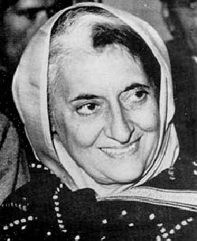

Slide 17
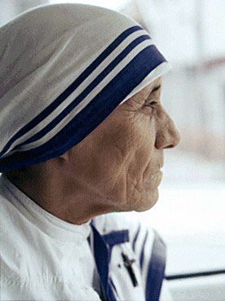

Slide 18


Slide 19
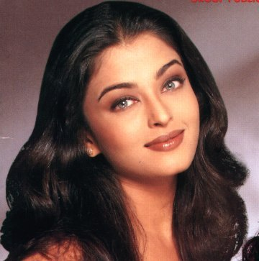

Slide 20


Slide 21
“The origin of a child is a mother, a woman. ….she shows a man what sharing, caring, and loving is all about. That is the essence of a woman."
Sushmita Sen, Miss Universe 1994

Slide 22
…but that is just a beginning….
thankyou….

