Slide 1
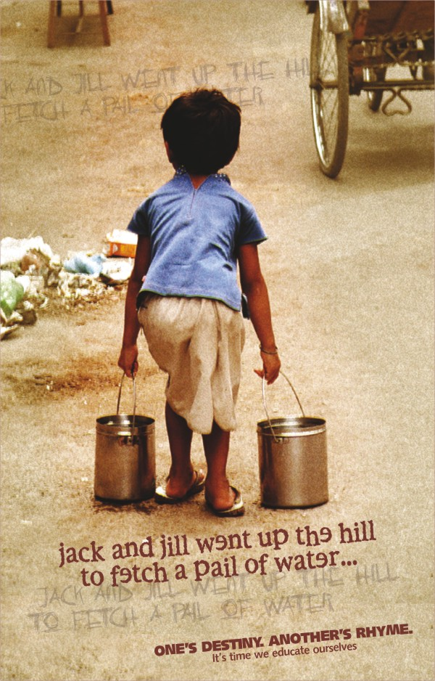
INTRODUCTION
Child labour refers to the employment of children at regular and sustained labour. This practice is considered exploitative by many international organizations and is illegal in many countries.

Slide 2
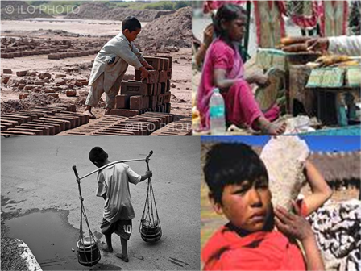
CAUSES
OVER POPULATION: Limited resources and more mouths to feed
ILLITERACY : Illiterate parents do not realize the need for a proper physical, emotional and cognitive development of a child.
POVERTY: Many a time poverty forces parents to send their children to hazardous jobs.
URBANIZATION:MNC's and export industries in the developing world employ child workers.
UNEMPLOYMENT OF ELDERS: Elders often find it difficult to get jobs. The industrialists and factory owners find it profitable to employ children.

Slide 3
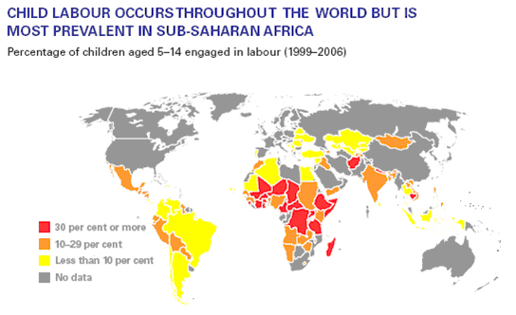
WORLD SCENARIO

Slide 4
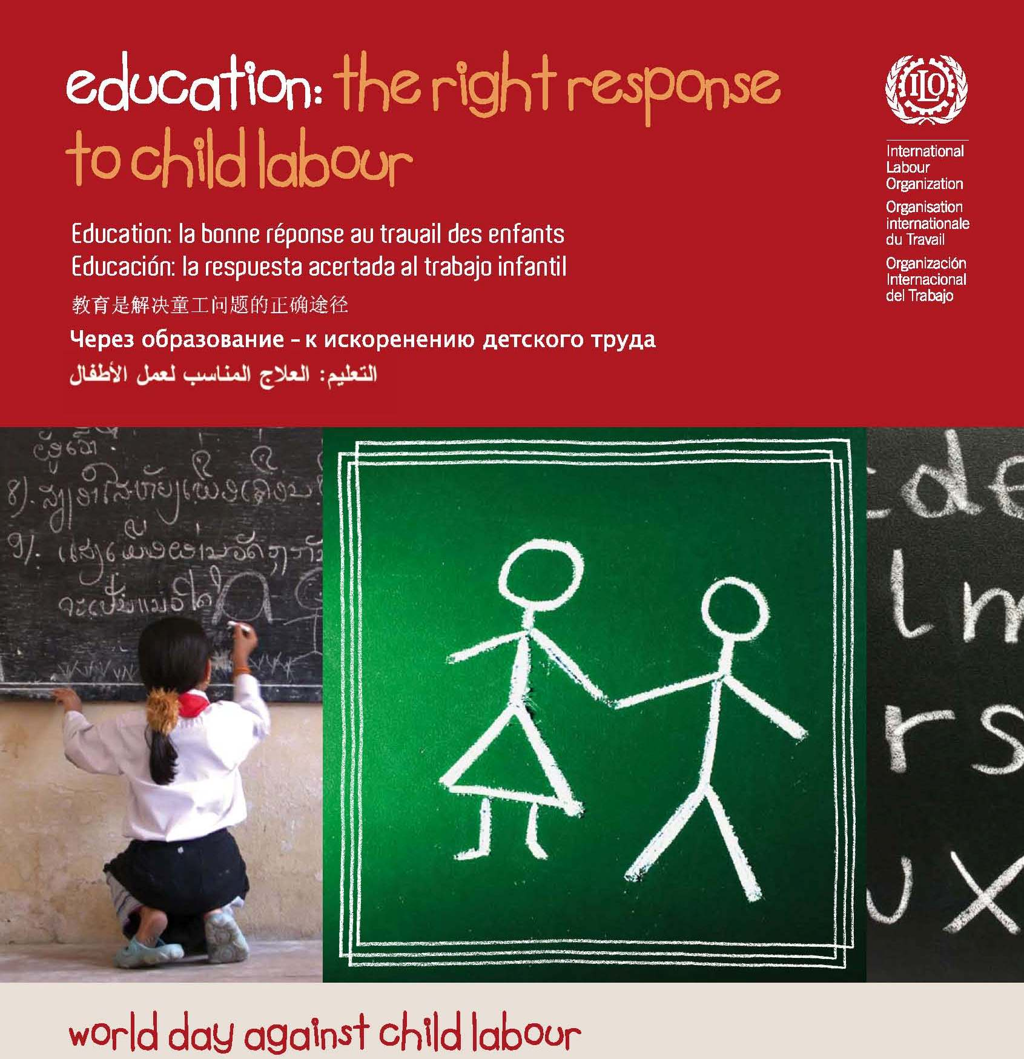
OUR MOTTO

Slide 5
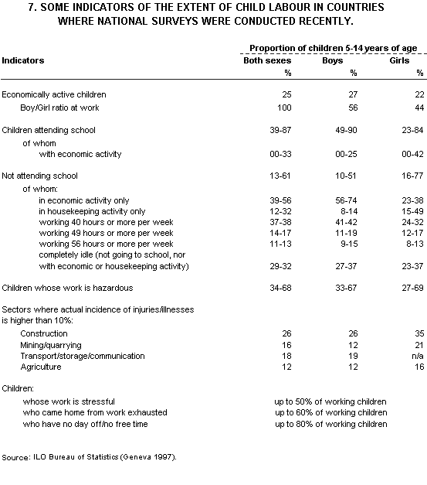
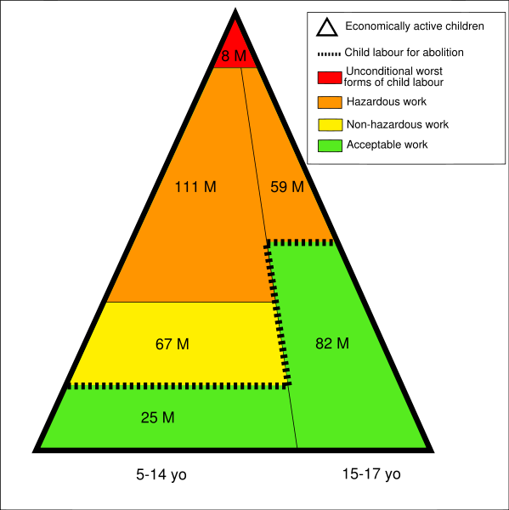
A SURVEY ON THE SITUATION

Slide 6
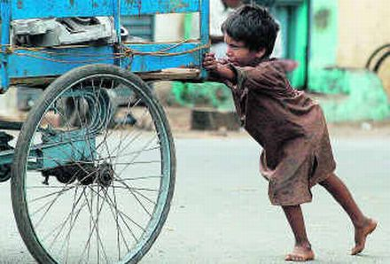
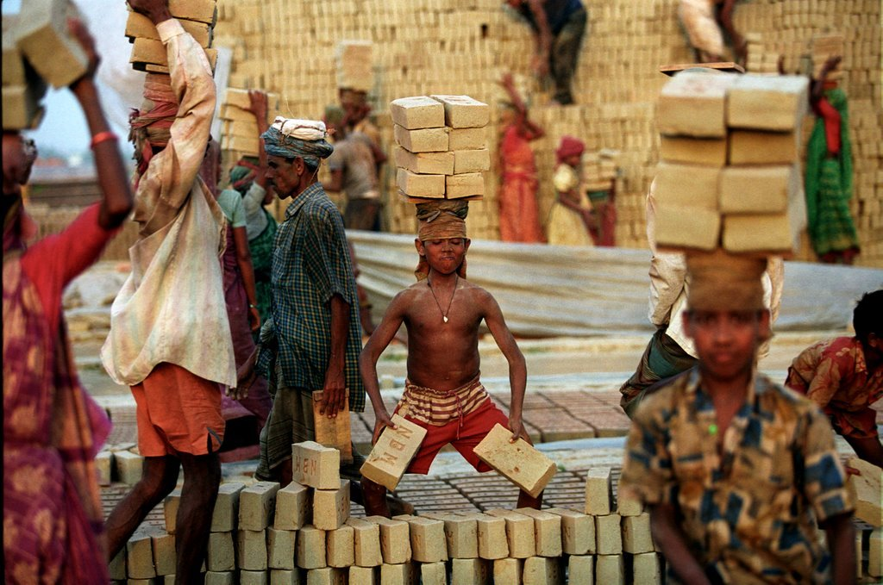
ATROCITIES COMMITTED
One of the most common atrocities committed on the children working in hazardous and stinking conditions is that they are subjected to callous and inhumane physical torture.
The extreme form of child labour sometimes leads to child abuse.

Slide 7
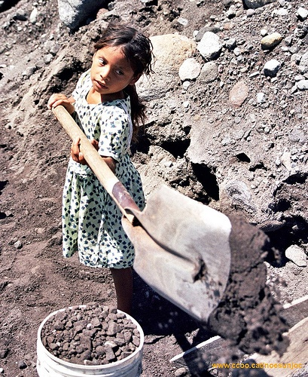
SITUATION IN INDIA
The situation in countries like India is even shoddier than other developed nations.

