Slide 1

RECESSION
INFLATION
AND
Country
Battles

Slide 2

?

Slide 3
A decline in GDP for two
Or more consecutive quarters.
A recession is typically
accompanied
By a drop in the stock market.

Slide 4
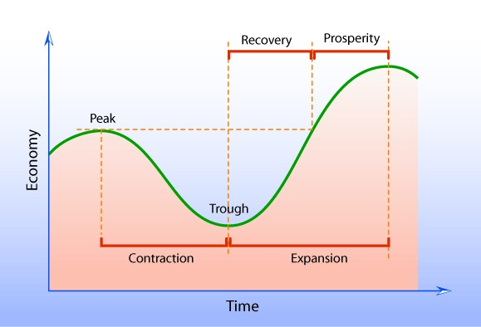
:
CAUSE
Tending of the rate of profit To fall
Underconsumption
Overproduction
Financial crisis
Currency crisis
Crisis theory
Energy crisis
War

Slide 5
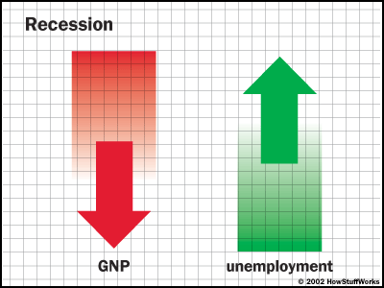
Effects of RECESSION
Bankrapticies
Credit crunches
Deflation
Foreclosures
Unemployment

Slide 6
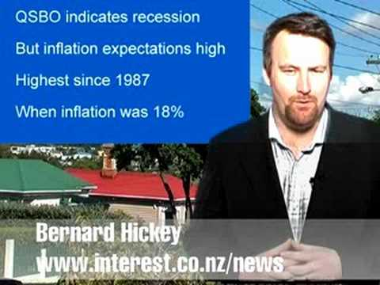
History of RECESSION
Global Recession
U K Recession
U S Recession
Late 2000s Recession
Other Countries

Slide 7
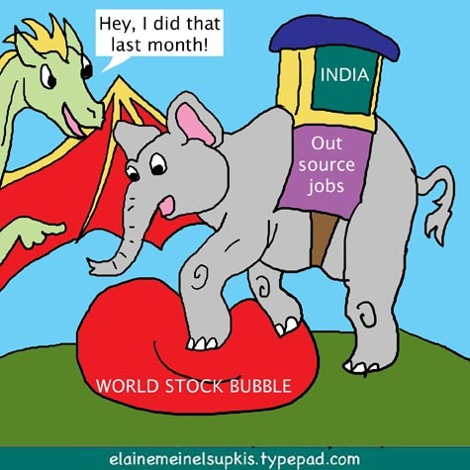
RECESSION in India
The global economic recession has taken
Its toll on the Indian economy that has led
To multi-crore loss in business and export
Orders, tens of thousands of job lossess
Especially in key sectors like the IT, automobiles,
Industry and export-oriented firms.

Slide 8
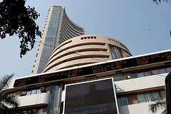
INFLATION ?

Slide 9
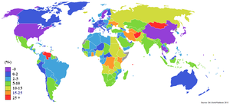
History of INFLATION
In 20th century, the following
Proliferation of private bank note
Currency printed during the
American Civil war, the term
Inflation started to appear as a
Direct reference to the currency Depreciation.

Slide 10
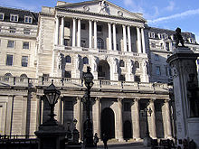
CAUSE:
Quantity theories of inflation
  Quality theories of inflation
    Currently quantity theory Of
money is widely accepted
As an accurate model
of inflation in long run.

Slide 11
EFFECTS:
Positive:
Increase in real value of the
Functional currency
Debt relief
Tobin effect
Labour market adjustments
Room to maneuver

Slide 12
NEGATIVE:
Cost push inflation
Hyperinflation
Allocative efficiency
Business cycles
Hording

Slide 13
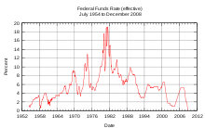
CONTROL MEASURES
MonetAry policy
Fixed exchanged rates
Gold standard
Wage and price control
Cost of living allowance

Slide 14
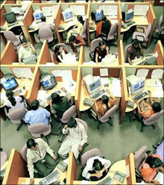
Tough times ahead for IT
Software multinationals in India
Have begun freezing wage increases,
Slushing salaries and postponing
Merit-based hikes,as steedy by
Indian consulting firm Zinnoy has found

Slide 15
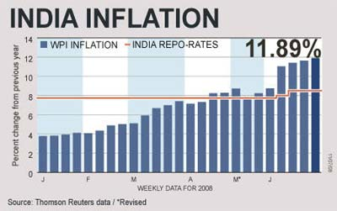
With sinking profits, eroding margins; cost cutting and are acquisition bid gone awry, 2008 was a year with more jeers than cheers for the country’s over $ 50 billions IT sector.

Slide 16

CONCLUSION
If there are problems, it is certain there will
be solutions of these problems as Spice
says there is always a smarter way.
Once you sought out one of them set another
goal for yourself. That’s the principal of life of
Our GRAND MASTER Sachin Ramesh Tendulkar.

Slide 17


REFERENCES
The Wikimedia Foundation
Business Cycle Expansions and Contractions The National Bureau Of Economic Research
Independent Analysis of Business Cycle Conditions - American Institute for Economic Research (AIER)

Slide 18
THANK YOU

