Slide 1
Fibre used in Telecom & Their Characteristics

Slide 2
Brief History
Optical communication systems date back to the 1790s, to the optical semaphore telegraph invented by French inventor Claude Chappe.
In 1880, Alexander Graham Bell patented an optical telephone system, which he called the Photophone.
By 1970 Corning Glass invented fiber-optic wire or "optical waveguide fibers" which was capable of carrying 65,000 times more information than copper wire.
Corning Glass developed with loss of 17 dB/km at 633 nm by doping titanium into the fiber core.
By June of 1972, multimode germanium-doped fiber had developed with a loss of 4 dB per kilometer and much greater strength than titanium-doped fiber.
Prof. Kao was awarded half of the 2009 Nobel Prize in Physics for "groundbreaking achievements concerning the transmission of light in fibers for optical communication".
Today more than 80 percent of the world's long-distance voice and data traffic is carried over optical-fiber cables

Slide 3
Fiber-Optic Applications
FIBRE OPTICS: The use and demand for optical fiber has grown tremendously and optical-fiber applications are numerous
Telecommunication applications are widespread, ranging from global networks to desktop computers.
These involve the transmission of voice, data, or video over distances of less than a meter to hundreds of kilometers, using one of a few standard fiber designs in one of several cable designs

Slide 4
ADVANTAGES OF FIBRE OPTICS
SPEED: Fiber optic networks operate at high speeds - up into the gigabits
BANDWIDTH: large carrying capacity
DISTANCE: Signals can be transmitted further without needing to be "refreshed" or strengthened.
RESISTANCE: Greater resistance to electromagnetic noise such as radios, motors or other nearby cables.
MAINTENANCE: Fiber optic cables costs much less to maintain.

Slide 5
Fiber Optic System
Information is Encoded into Electrical Signals.
Electrical Signals are Coverted into light Signals.
Light Travels Down the Fiber.
A Detector Changes the Light Signals into Electrical Signals.
Electrical Signals are Decoded into Information.
    Inexpensive light sources available.
    Repeater spacing increases along with operating speeds because low loss
    Fibres are used at high data rates.

Slide 6
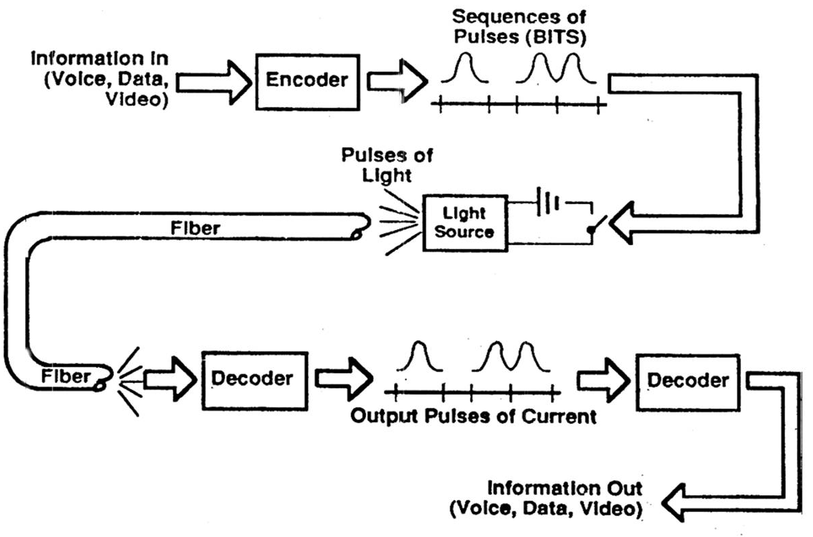

Slide 7
Principle of Operation - Theory
Total Internal Reflection
  The Reflection that Occurs when a Light Ray Travelling in One Material Hits a Different Material and Reflects Back into the Original Material without any Loss of Light
  Speed of light is actually the velocity of electromagnetic energy in vacuum such as space.
  Light travels at slower velocities in other materials such as glass.
  Light travelling from one material to another changes speed, which results in light changing its direction of travel.
  This deflection of light is called Refraction

Slide 8
.

Slide 9
PROPAGATION OF LIGHT THROUGH FIBRE
The optical fibre has two concentric layers called the core and the cladding.
The inner core is the light carrying part.
The surrounding cladding provides the difference refractive index that allows total internal reflection of light through the core.
The index of the cladding is less than 1%, lower than that of the core.
Typical values, for example, are a core refractive index of 1.47 and a cladding index of 1.46.
Fibre manufacturers control this difference to obtain desired optical fibre characteristics.
Most fibres have an additional coating around the cladding.
This buffer coating is a shock absorber and has no optical properties affecting the propagation of light within the fibre.

Slide 10
Specific characteristics of light depends on
The size of the fibre.
The composition of the fibre.
The light injected into the fibre.

Slide 11
.

Slide 12
Geometry of Fiber

Slide 13
Diameters of the core and cladding
.

Slide 14
FIBRE TYPES
Step Index
Graded Index
By this classification there are three types of fibres :
  Multimode Step Index fibre (Step Index fibre)
  Multimode graded Index fibre (Graded Index fibre)
  Single- Mode Step Index fibre (Single Mode Fibre)

Slide 15
STEP-INDEX MULTIMODE FIBER
large core, up to 100 microns in diameter.
As a result, some of the light rays that make up the digital pulse may travel a direct route, whereas others zigzag as they bounce off the cladding.
These alternative pathways cause the different groupings of light rays, referred to as modes, to arrive separately at a receiving point.
The pulse, an aggregate of different modes, begins to spread out, losing its well-defined shape.
The need to leave spacing between pulses to prevent overlapping limits bandwidth that is, the amount of information that can be sent.
Consequently, this type of fiber is best suited for transmission over short distances, in an endoscope, for instance

Slide 16
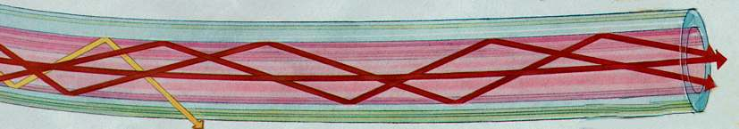

Slide 17
GRADED-INDEX MULTIMODE FIBER
Contains a core in which the refractive index diminishes gradually from the center axis out toward the cladding.
The higher refractive index at the center makes the light rays moving down the axis advance more slowly than those near the cladding
Also, rather than zigzagging off the cladding, light in the core curves helically because of the graded index, reducing its travel distance.
The shortened path and the higher speed allow light at the periphery to arrive at a receiver at about the same time as the slow but straight rays in the core axis.
The result: a digital pulse suffers less dispersion.

Slide 18
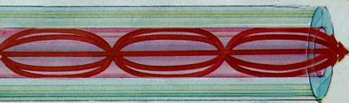

Slide 19
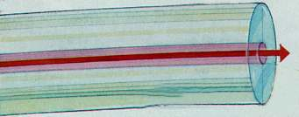
SINGLE-MODE FIBER
has a narrow core (eight microns or less), and the index of refraction between the core and the cladding changes less than it does for multimode fibers.
Light thus travels parallel to the axis, creating little pulse dispersion.
Telephone and cable television networks install millions of kilometers of this fiber every year

Slide 20
OPTICAL FIBRE PARAMETERS
Wavelength.
Frequency.
Window.
Attenuation.
Dispersion.
Bandwidth

Slide 21
WAVELENGTH
It is a characterstic of light that is emitted from the light source and is measured in nanometers (nm).
In the visible spectrum, wavelength can be described as the colour of the light.
For example, Red Light has longer wavelength than Blue Light.
Typical wavelength for fibre use are 850nm, 1300nm and 1550nm all of which are invisible

Slide 22
FREQUENCY
It is number of pulse per second emitted from a light source.
Frequency is measured in units of hertz (Hz).
In terms of optical pulse 1Hz = 1 pulse/ sec.

Slide 23
WINDOW
A narrow window is defined as the range of wavelengths at which a fibre best operates.
Typical windows are given below :
Window | Operational Wavelength
800nm - 900nm | 850nm
1250nm - 1350nm | 1300nm
1500nm - 1600nm | 1550nm

Slide 24
ATTENUATION
Attenuation is defined as the loss of optical power over a set distance, a fibre with lower attenuation will allow more power to reach a receiver than fibre with higher attenuation.
Attenuation may be categorized as
  intrinsic or
  extrinsic

Slide 25
INTRINSIC ATTENUATION
Absorption - Natural Impurities in the glass absorb light energy
Scattering - Light Rays Travelling in the Core Reflect from small Imperfections into a New Pathway that may be Lost through the cladding.

Slide 26
.
.

Slide 27
EXTRINSIC ATTENUATION
Macrobending
  The fibre is sharply bent so that the light travelling down the fibre cannot make the turn & is lost in the cladding.
Microbending
  Microbending or small bends in the fibre caused by crushing contraction etc.
  These bends may not be visible with the naked eye.

Slide 28
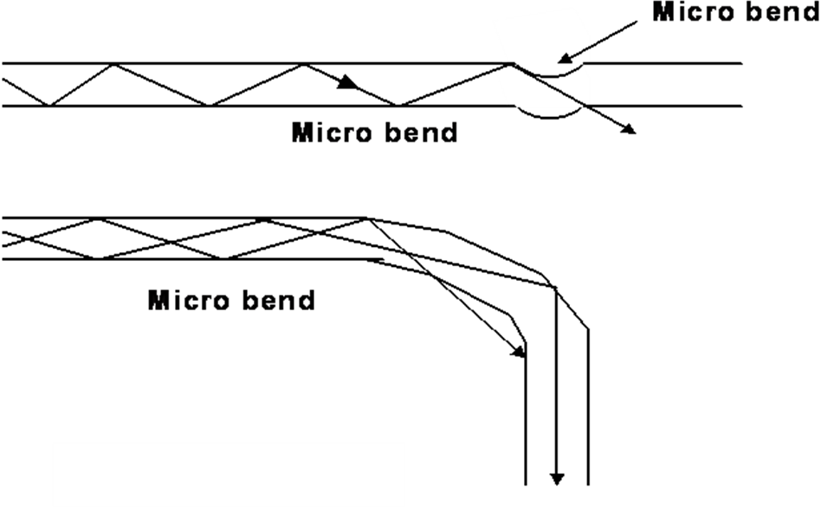
.

Slide 29
DISPERSION
Dispersion is the spreading of light pulse as its travels down the length of an optical fibre
Dispersion limits the bandwidth or information carrying capacity of a fibre.
The bit-rates must be low enough to ensure that pulses are farther apart and therefore the greater dispersion can be tolerated

Slide 30
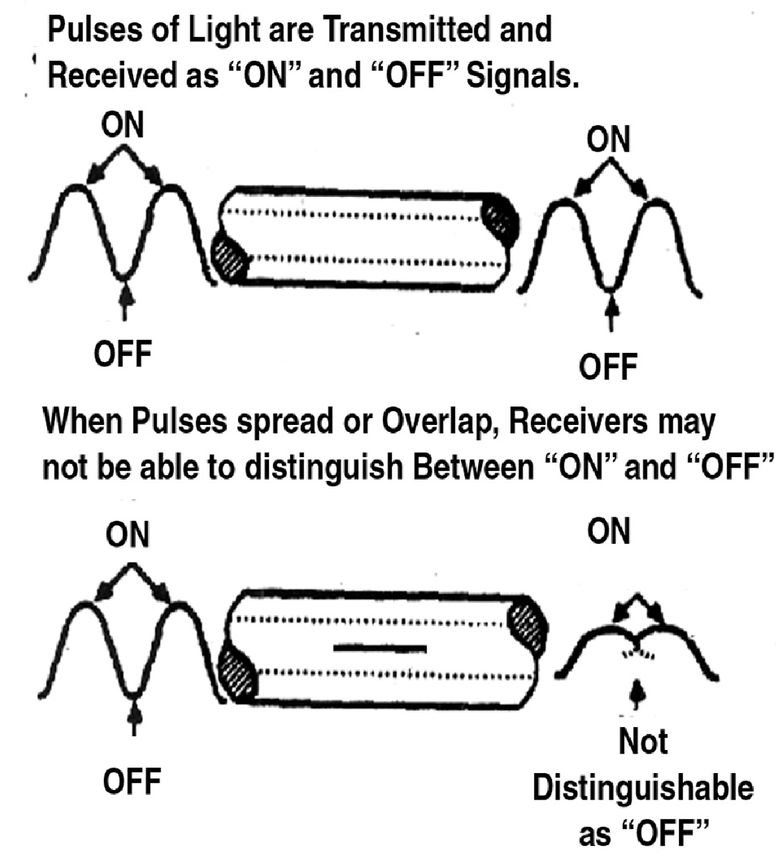

Slide 31
Types of dispersion
Modal Dispersion
Material dispersion
Waveguide dispersion

Slide 32
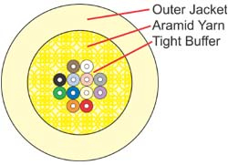
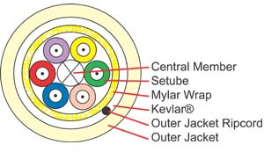
CABLE CONSTRUCTION
Tight Buffer Tube Cable
Loose Buffer Tube Cable

Slide 33
Cable Components
Component | Function | Material
Buffer | Protect fibre From Outside | Nylon, Mylar, Plastic
Central Member | Facilitate Stranding Temperature Stability Anti-Buckling | Steel, Fibreglass
Primary Strength Member | Tensile Strength | Aramid Yarn, Steel
Cable Jacket | Contain and Protect Cable Core Abrasion Resistance | PE, PUR, PVC, Teflon
Cable Filling Compound | Prevent Moisture intrusion and Migration | Water Blocking Compound
Armoring | Rodent Protection Crush Resistance | Steel Tape

Slide 34
OFC Splicing
Adhesive bonding or Glue splicing.
Mechanical splicing.
Fusion splicing.

Slide 35
Thanks

