Slide 1
INTRODUCTION
EFFECT OF HORROR SHOWS ON CHILDREN
Psychological research has found that televised violence has numerous effects on the
behaviour of children of different ages.

Slide 2
Infants (children up to 18 months)
Extent of attention span for watching television

Slide 3
Toddlers (Children 18 Months to 3 Years Old):
Approach to watching television.
Potential effects of television violence.

Slide 4
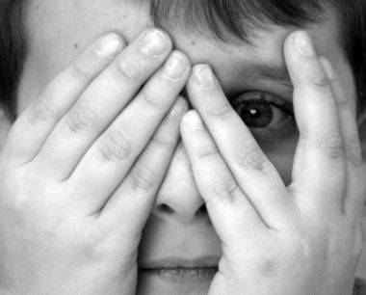
Early Childhood or Preschool Age (Children Ages 3 to 5):
Attraction to television violence.
Preference for cartoons

Slide 5
Middle Childhood or Elementary School Age (Children Ages 6 to 11):
Particular susceptibility to the effects of violent television
Television content that children find scary

Slide 6
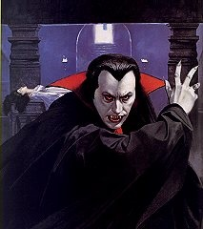
Adolescence (Children Ages 12 to 17):
Attraction to horror movies, music videos .
Susceptibility to imitating television violence and crime.

Slide 7
THANK YOU

