Slide 1

REALITY SHOWS AND ITS IMPACTS

Slide 2

What is a reality show?????
Genre of television programming
Portrays modified form of reality
Create an illusion thru post-production
techniques

Slide 3
Types of Reality Shows
Celeb-Reality: Reality shows with celebrities .
Example:Jhalak Diklaja, Big Boss
Prank-Reality: Reality shows involving pranks played on ordinary people and capturing their candid reaction.
Examples:Candid Camera,MTV Bakra
Game Shows: Reality shows that are based on games.
Examples:Kaun Banega Crorepati

Slide 4
Talent Hunts: Reality shows looking for talented people be it singers, dancers or even actors.
Example: Indian Idol, Dance India Dance
Job-hunts: Shows that are synonymous with live on air interviews are listed under this category.
Example: The Apprentice, On the Lot (Directors),
Makeovers: Shows with make over stories be it a personal makeover or a home make over.
Example: While You Were Out,

Slide 5
Dating-Shows: Reality shows giving a platform for dating men and women on air.
Example: Perfect Match New York
Social Experiments: new genre of reality tv that involves interaction of distinct social groups.
Example: The Beauty and the Geek, Wife Swap, My Big Fat Obnoxious Fiancé.
Adventure/Fear based shows: A genre of TV shows that challenges the participants with difficult and weird tasks.
Example: Fear Factor, Roadies

Slide 6

Advantages:
Offers an opportunity to gain instant exposure, fame or money.
Gives a chance to narrate a story or promote a cause.
.

Slide 7
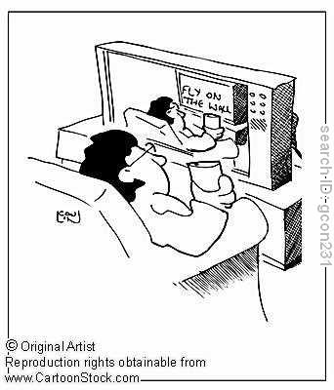
Helps in increasing one's confidence level and self-awareness.
Enhances the analytical abilities of the viewer.
Gives high levels of entertainment and thrill.

Slide 8

Disadvantage
• Invasion of Privacy.
• Generates social, moral and ethical conflicts in the viewer.

Slide 9

Embarrassment, Humiliation and Loss of Reputation of participants.
Invokes legal action for libel, slander, trespass, fraud and negligence resulting in bodily harm or damage to property.

Slide 10
Impact of realityshows
Positive impact
Contestants get chance to voice
Their opinion
Enjoy celebrity status
Talented people get much-needed break

Slide 11
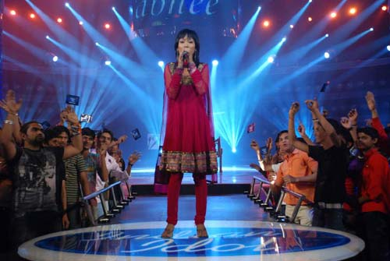
Reality shows:a big hit today
first catalyst :money
second: instant fame.
third: guilty pleasure
syndrome

Slide 12
Negative impact
Fall into oblivion
Indulge in outrageous behaviour
in public
When unsucesful go towards
depression

Slide 13
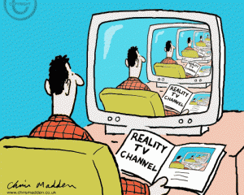
Effects of reality shows on viewers :
hooked on to tv shows which really do not have intelligent concepts.e.g big boss,sach ka samna etc.

Slide 14
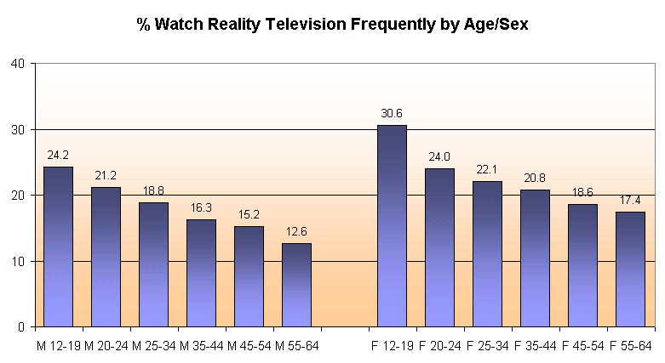

Slide 15
Shocking faces of
Reality shows
Freak incident:
Chandan singh –a nine year old boy
hanged himself accidently
By imitating stunt off the show
(ROADIES)

Slide 16
Psychological effects
Shinjini sengupta became paralyzed
after suffering rebuke from judges
In reality show last year in Bengali channel

Slide 17
Thank you

