Slide 1
OF TRANSMISSION SYSTEMS & THEIR FEATURES

Slide 2
PDH (Plesiochronous digital hierarchy)
To cope with the demand for ever higher bit rates, a multiplex hierarchy called the plesiochronous digital hierarchy (PDH) evolved.
The bit rates start with the basic multiplex rate of 2 Mbit/s with further stages of 8, 34 and 140 Mbit/s.
In North America and Japan, the primary rate is 1.5 Mbit/s. Hierarchy stages of 6 and 44 Mbit/s developed from this.
Because of these very different developments, gateways between one network and another were very difficult and expensive to realize
A transmission rate of 2048 kbit/s results when 30 such coded channels are collected together into a frame along with the necessary signaling information.
This so-called primary rate is used throughout the world.
Only the USA, Canada and Japan use a primary rate of 1544 kbit/s, formed by combining 24 channels instead of 30
A practically synchronous (or, to give it its proper name: plesiochronous) digital hierarchy is the result

Slide 4
Main problems of PDH
Homogeneity of equipment
Problem of Channel segregation
The problem cross connection of channels
Inability to identify individual channels in a higher-order bit stream.
Insufficient capacity for network management;
Most PDH network management is proprietary.
There’s no standardized definition of PDH bit rates greater than 140 Mb/s.
There are different hierarchies in use around the world.
Specialized interface equipment is required to interwork the two hierarchies.

Slide 5
Synchronous Digital Hierarchy (SDH)
Avoid the problems of PDH
Achieve higher bit rates (Gbit/s)
Better means for Operation, Administration, and Maintenance (OA&M)
SDH is an ITU-T standard for a high capacity telecom network.
SDH is a synchronous digital transport system, aim to provide a simple, economical and flexible telecom infrastructure.
The basis of SDH is synchronous multiplexing - data from multiple tributary sources is byte interleaved.

Slide 6
Advantages of SDH
High transmission rates
Simplified add & drop function
High availability and capacity matching
Reliability
Interconnection
Future-proof platform for new services

Slide 7
Network Elements of SDH
Regenerators
Terminal Multiplexer
Network Element Manager
Digital Cross-connect
Add/drop Multiplexers(ADM)

Slide 8
SDH Rates
STM-1 = 155.52 Mbit/s
STM-4 = 622.08 Mbit/s
STM-16 = 2588.32 Mbit/s
STM-64 = 9953.28 Mbit/s

Slide 9
Automatic protection switching (APS)
Two basic types of protection architecture are distinguished in APS.
One is the linear protection mechanism used for point-to-point connections.
The other basic form is the so-called ring protection mechanism which can take on many different forms.
Both mechanisms use spare circuits or components to provide the back-up path

Slide 10
Linear protection

Slide 11
Ring protection
Unidirectional rings
Bi-directional rings

Slide 12
Unidirectional rings

Slide 13
Bi-directional rings

Slide 14
DENSE WAVELENGTH DIVISION MULTIPLEXING
DWDM technology, a new and probably, a very crucial milestone is being reached in network evolution.
The existing SONET/SDH network architecture is best suited for voice traffic rather than today’s high-speed data traffic
To meet growing demands for bandwidth, a technology called DWDM has been developed that multiplies the capacity of a single fiber.
DWDM systems being deployed today can increase a single fiber’s capacity sixteen fold, to a throughput of 40 Gb/s.
The emergence of DWDM is one of the most recent and important phenomena in the development of fiber optic transmission technology.
DWDM revolutionized transmission technology by increasing the capacity signal of embedded fiber

Slide 15
WDM
In traditional optical fiber networks, information is transmitted through optical fiber by a single light beam.
In a wavelength division multiplexing (WDM) network, the vast optical bandwidth of a fiber is carved up into wavelength channels, each of which carries a data stream individually.
The multiple channels of information (each having a different carrier wavelength) are transmitted simultaneously over a single fiber.
The reason why this can be done is that optical beams with different wavelengths propagate without interfering with one another.
When the number of wavelength channels is above 20 in a WDM system, it is generally referred to as Dense WDM or DWDM.

Slide 16
DEVELOPMENT OF DWDM TECHNOLOGY
.

Slide 17
VARIETIES of WDM
WDM
  wide-spread with 2, 4, 8, 12, and 16 channel counts being the normal deployments.
  This technique usually has a distance limitation of less than 100 km.
CWDM
  common spacing may be 200, 100, 50, or 25 GHz with channel count reaching up to 128 or more channels at distances of several thousand kilometers with amplification and regeneration along such a route.
DWDM
  made up of 18 wavelengths defined within the range 1270 nm to 1610 nm spaced by 20 nm.

Slide 18
DWDM System Function
Dense wavelength division multiplexing systems allow many discrete transports channels by combining and transmitting multiple signals simultaneously at different wavelengths on the same fiber.
In effect, one fiber is transformed into multiple virtual fibers.
So, if you were to multiplex 32 STM-16 signals into one fiber, you would increase the carrying capacity of that fiber from 2.5 Gb/s to 80 Gb/s.
Currently, because of DWDM, single fibers have been able to transmit data at speeds up to 400Gb/s.

Slide 19
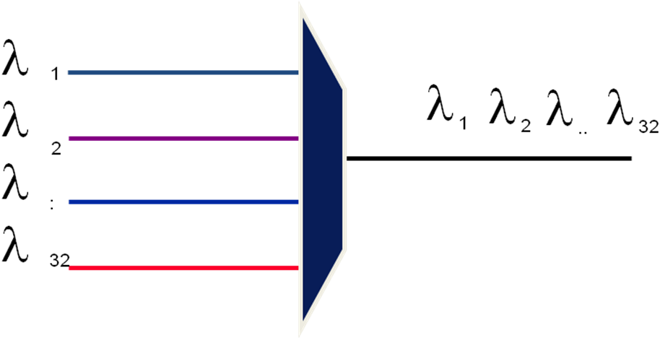
Block Diagram of a DWDM System
.

Slide 20
TRANSMISSION WINDOWS
usually the second transmission window (around 1300 nm) and the third and fourth transmission windows from 1530 to 1565 nm (also called conventional band) and from 1565 to 1620 nm (also called Long Band) are used.
Technological reasons limit DWDM applications at the moment to the third and fourth window.
The losses caused by the physical effects on the signal due by the type of materials used to produce fibres limit the usable wavelengths to between 1280 nm and 1650 nm.
Within this usable range the techniques used to produce the fibres can cause particular wavelengths to have more loss so we avoid the use of these wavelengths as well.

Slide 21
DWDM SYSTEM COMPONENTS
Transmitter (transmit transponder):
Receiver (receive transponder)
Amplifier:
Optical fiber (media):
Multiplexer/ demultiplexer:

Slide 22
DWDM System Components

Slide 23
BENEFITS of DWDM
Increases bandwidth (speed and distance)
Does not require replacement or upgrade their existing legacy systems
Provides "next generation" technologies to meet growing data needs
Less costly in the long run because increased fiber capacity is automatically available; don't have to upgrade all the time.

Slide 24
OPTICAL NE TYPES
Optical Multiplexer/Demultiplexer
Optical Amplifiers
Transponders
Regenerators
Optical cross-connects
Optical Add/Drop Multiplexer

Slide 25
DWDM Backbone Networks
Simple point-point DWDM link,
DWDM wavelength routing with electronic TDM (time domain multiplexing) and switching/routing backbone network, and
All-optical DWDM network.

Slide 26
DWDM point-to-point link backbone network
.

Slide 27
Wavelength routing with electronic TDM DWDM networks
.

Slide 28
All-optical TDM/switch with wavelength router
.

Slide 29
.
Thanks

